Slide 1
Climate Change & Emissions Analytics Dashboard (SDG Goal 13: Climate Action)

Slide 2
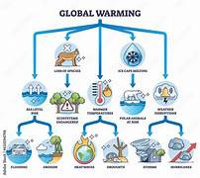
Abstract
Climate change is a global challenge caused by rising greenhouse gas emissions and increasing temperatures. This project develops an interactive analytics dashboard to monitor climate indicators, analyze emissions trends, and predict climate risk levels using machine learning techniques. The solution helps stakeholders make data-driven environmental decisions.

Slide 3
Introduction
Climate change poses one of the greatest challenges of our time, with rising global temperatures, increasing greenhouse gas emissions, and extreme weather events threatening ecosystems and human societies. This project aims to design and implement a Climate Analytics Dashboard that consolidates climate-related data, applies machine learning (ML) for predictive insights, and supports evidence-based policy decisions.

Slide 4
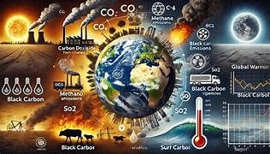
Problem Statement
Current climate data is fragmented,
underutilized, and lacks predictive modeling.
This results in:
Poor climate policy decisions
Increased environmental damage
Absence of early warning systems
A centralized, interactive dashboard with
ML-driven insights is required to address these gaps.

Slide 5
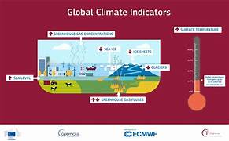
Objectives
Monitor climate change indicators (emissions,
temperature, energy usage).
Identify high-risk regions using clustering and
classification models.
Predict future climate risks through ML.
Provide actionable insights for policymakers and
environmental agencies.

Slide 6
Scope
Scope
In Scope:
Data preprocessing and cleaning
KPI calculation
Dashboard creation (Power BI / Tableau)
ML model implementation (classification, regression, clustering)
Insights generation
Out of Scope:
Real-time climate control systems
Direct enforcement of environmental policies

Slide 7

Stakeholders
Environmental Agencies
Government Bodies
Climate Researchers
Policy Makers

Slide 8
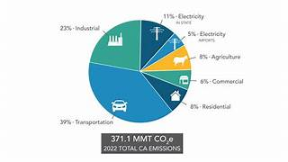
Data Requirements
Emissions Data: CO₂ emissions, greenhouse gas levels Environmental Data: Temperature changes, sea level rise Energy Data: Fossil fuel usage, renewable energy adoption Geographic Data: Region, population Target Variable: Climate Risk Level (High / Medium / Low)

Slide 9
Key Metrics (KPIs)
CO₂ Emissions (tons)
Temperature Increase Rate
Carbon Footprint Index
Renewable Energy Share (%)
Climate Risk Score
Region-wise Risk Ranking

Slide 10
Analytical Approach
EDA: Emission trends, correlation analysis (temperature vs emissions).
Feature Engineering: Climate index, risk score.
Segmentation: K-Means clustering for risk zones.
Modeling (ML):
Classification → Predict climate risk level
Regression → Predict emissions/temperature trends
Clustering → Identify high-risk zones
Visualization: Power BI/Tableau dashboard with KPIs, maps, charts, and filters.

Slide 11
Tools & Tech Stack
Python: Pandas, NumPy, Matplotlib, Seaborn, Scikit-learn
Visualization: Power BI, Tableau
Storage: CSV / Excel
Documentation: Jupyter Notebook + Final Report

Slide 12
Dashboard Layout
Top KPIs: CO₂ emissions, temperature change, climate risk score
Regional Analysis: Map (risk levels), bar chart (emissions by region)
Trend Section: Climate trends over time
Comparison Section: Region vs Region
Filters: Region, year, emission type

Slide 13
Deliverables
cleaned_climate_data.csv
climate_metrics.csv
Dashboard file (.pbix / Tableau workbook)
Jupyter Notebook (EDA + ML + KPIs)
Final Report

Slide 14
Success Metrics
Accurate climate risk prediction
Effective ML model performance
Clear visualization of insights
Actionable recommendations for stakeholders

Slide 15
Risks & Assumptions
Missing or incomplete environmental data
Inconsistent measurement standards across regions
Limited historical records

